Slide 1
Modern Control Theory
Model Predict Control - MPC – Lecture 1
Introduction

Slide 2
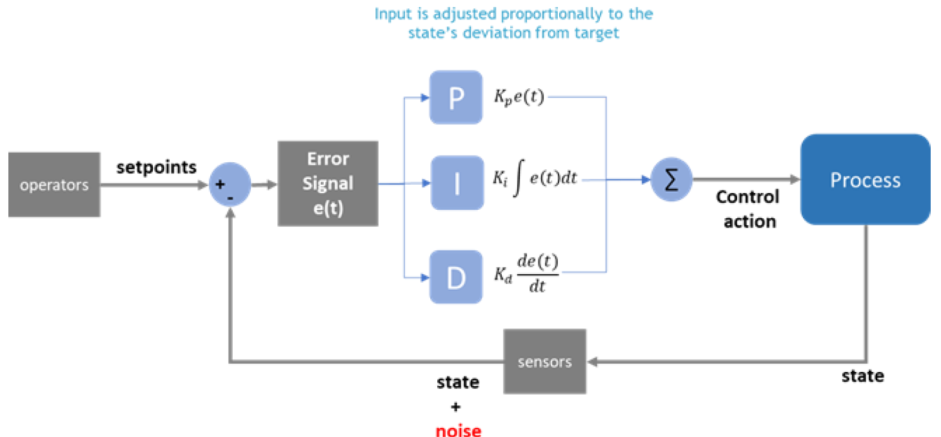
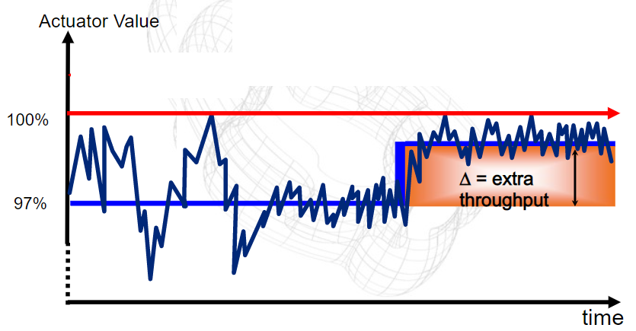
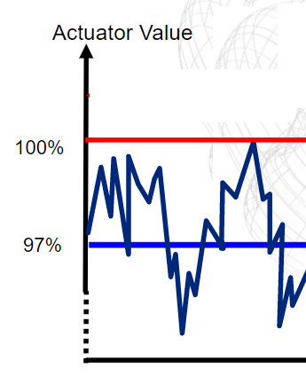
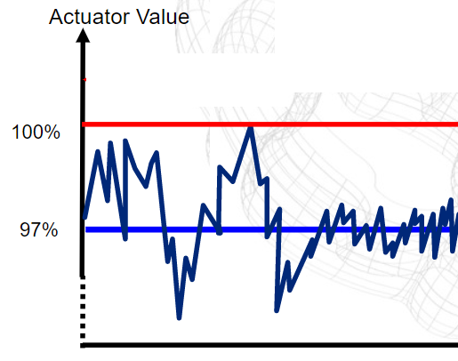
PID controls – fundamental block
How many control loops are there in a refinery
10-100
1-10
1000-2000
100-500
Design –
mainly offline,
Gets complex with multi loops
doesn’t cater to changing conditions
Focus on local performance with limited incorporation of disturbance effects

Slide 3


What is MPC (1/5)?
Scenario 1
What will be the action?
Slow down the car?
Go at the same speed?
Reduce slightly and increase after signal?
Speed profile
Speed of car = 60km/hr
Distance = 2 km
Signal Red light for 30 secs
Why this action?
Speed?
Scenario 2
What will be the action?
Slow down the car?
Go at the same speed?
Reduce acceleration and increase after signal?
Speed of car = 60km/hr
Distance = 0.75 km
Signal Red light for 30 secs
Why this action?
Speed?
Scenario 3
What will be the action?
Slow down the car?
Go at the same speed?
Reduce acceleration and increase after signal?
Speed of car = 60km/hr
Distance = 0.5 km
Signal Red light for 30 secs
Speed?
Why this action?

Slide 4
What is MPC (2/5)
What objectives the actions were serving?
Break as less as possible
Slow down as minimal from ?
Why?
Fuel efficiency/ cost saving
Constraints?
Signal violation?
Abrupt braking?
First definition of MPC:
MPC is a controller which uses prediction to decide the current/future control actions such that to satisfy the desired objectives without violation of constraints.
CV – controlled variable - SPEED
MV – Manipulated variable – Fuel injection, Break
DV – Disturbance variable - time duration in red light
Was there a model here?

Slide 5
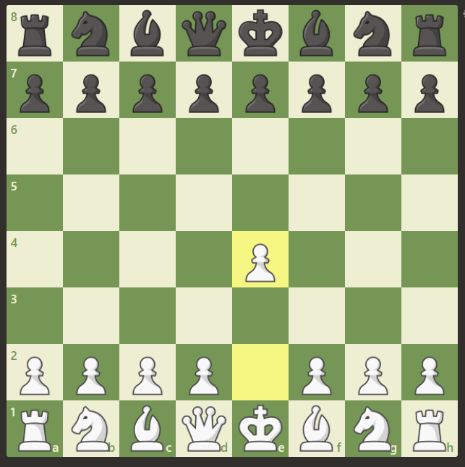
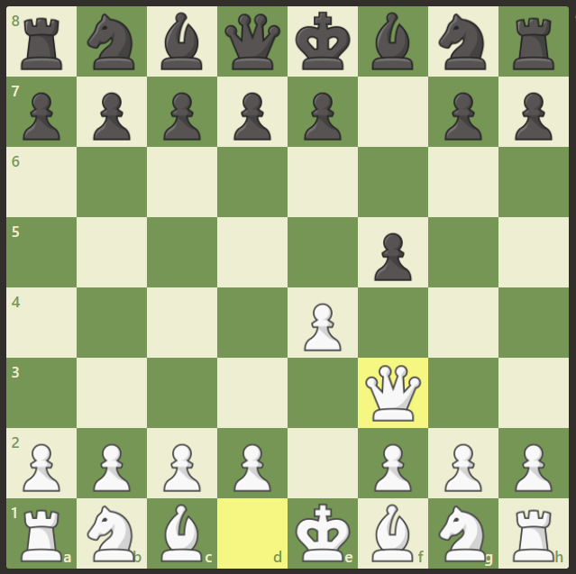
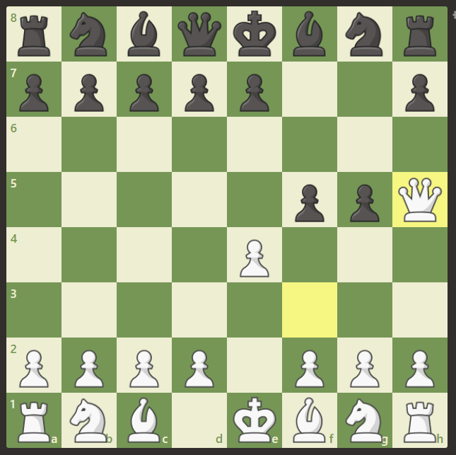
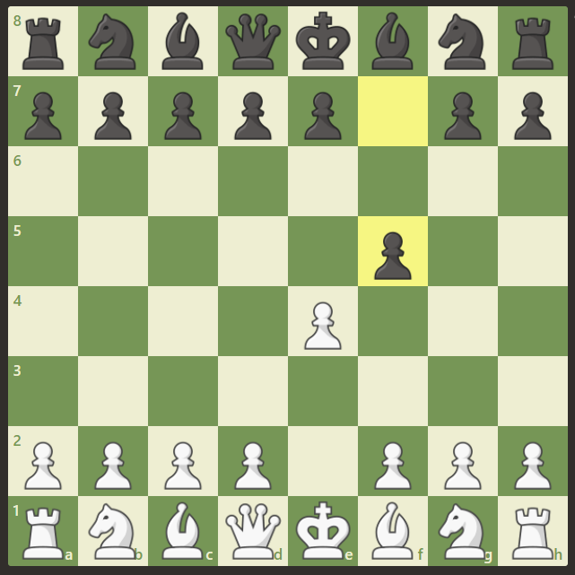
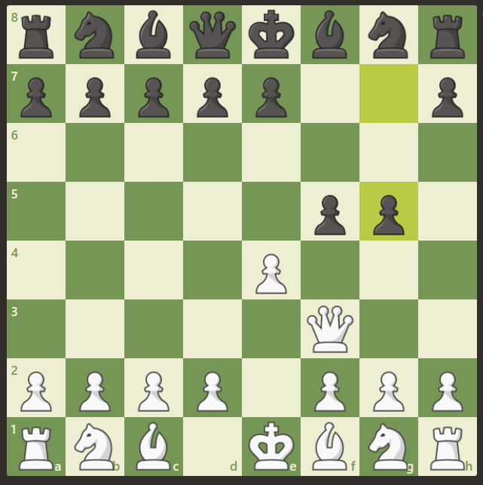
What is MPC (3/5)
Second example - Beating the opponent in 3 moves
Winner
Loser

Slide 6
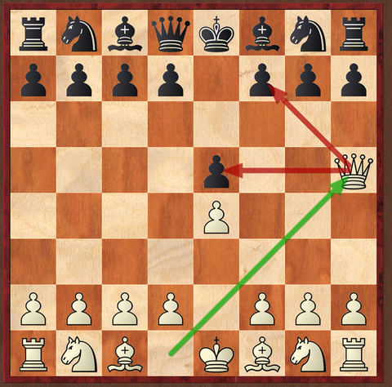
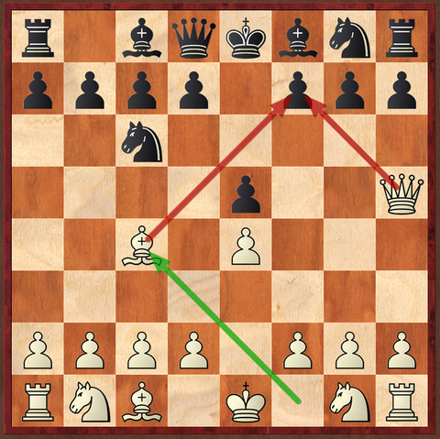
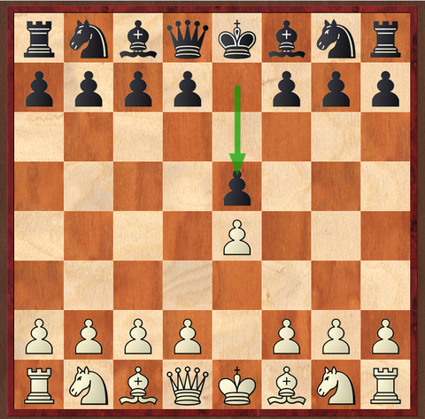
What is MPC (4/5)
Second example - Beating the opponent in 4 moves
Winner
Loser

Slide 7
What is MPC? (5/5)
Important observations
What objectives the actions were serving?
Win in as fewer moves as possible
Why?
Longer, the less probability to win
Constraints?
Play within the chess rules
Prediction was done as many steps ahead required for winning if possible
Every move, current and past had an impact on the future of the game
Prediction was re-done again after every move

Slide 8
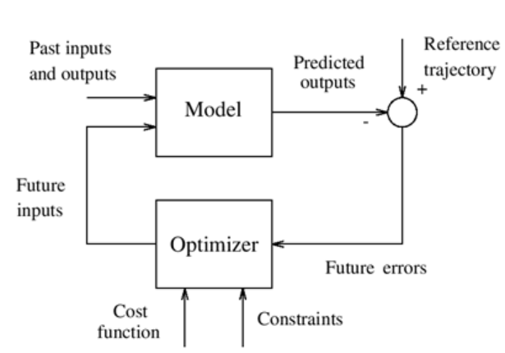
What is MPC (finally?)
Second definition of MPC:
MPC is a controller which uses prediction that includes the effect of past and future control actions such that to satisfy the desired objectives without violation of constraints but implements only the first time-step action.
KEY ELEMENTS OF MPC
Prediction Model
Effect of past actions onto the future (implemented)
Effect of current and future actions (to be implemented)
Objectives with Constraints to be met on Input action, Output deviations
Optimizer to obtain the control actions
Line in CHESS, Implementing the first step of current move calculations and re-computing the control trajectory at each time step is called Receding Horizon control

Slide 9
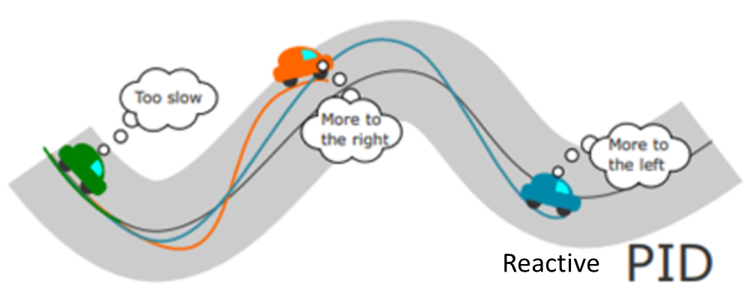
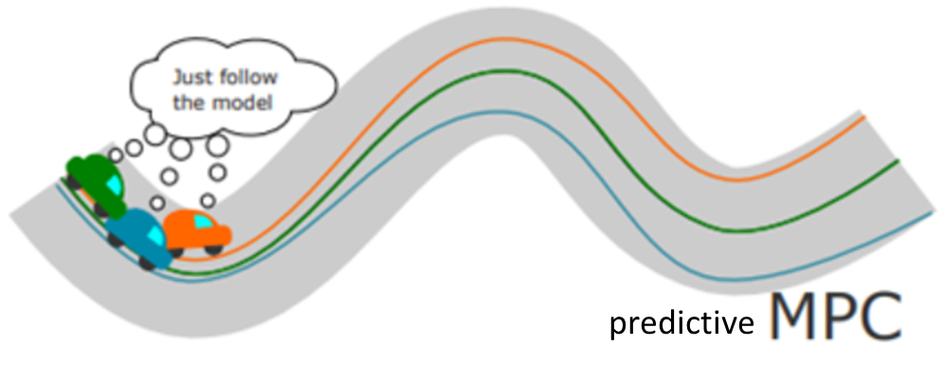
Key advantages of MPC
MPC Controller actions keeps System objectives met as much as possible in real-time by
Driving the economics closer to optimal without sacrificing safety limits
Handles constraints on key variables, both on the inputs and outputs
Smoother operations through elegantly addressing interactions through predictions, keeping the variance with target as low as possible
Open loop control
Classical control
MPC

Slide 10
Brief on Sampling
Zero-order-hold

Slide 11
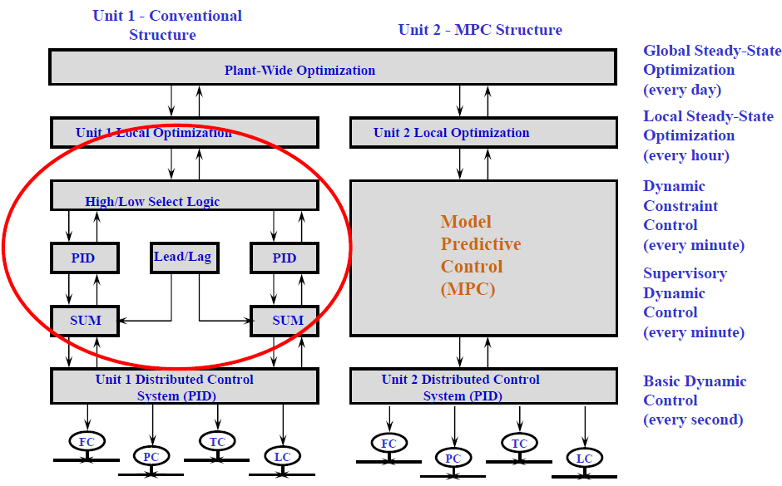
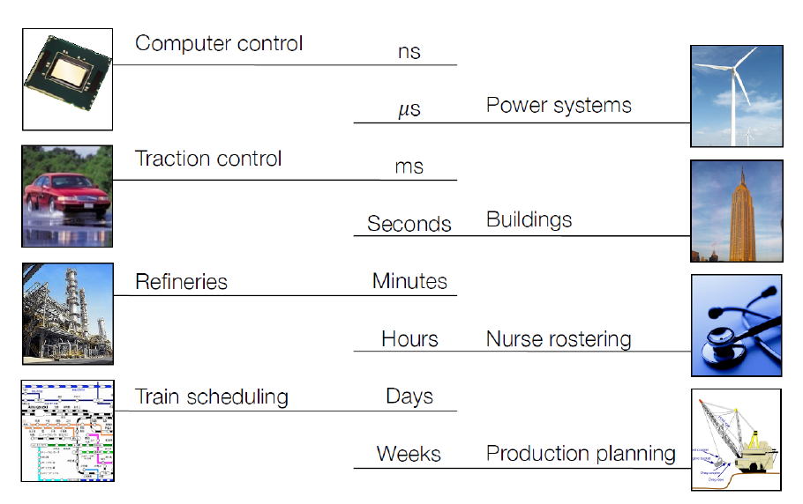
The control pyramid – Role of MPC
Refinery/ Process industry
Important observations
Computation was limiting the application to Refineries in the 90s (minutes)
Today - MPC applications operates in few mill-seconds (Cruise control)

Slide 12
Some applications of MPC
35+ years in refineries and petrochemicals
Upcoming fields
Robotics,
Cruise control,
optimizing buffering and quality in video streaming ,
Path planning – autonomous vehicles
etc

Slide 13
Course organization
Simulation model types (Impulse, step, state space) - Prediction equations, use of Kalman filter in prediction equation
Control solution for unconstrained system
Optimization with constrains
Industrial MPC implementations – Honeywell control
MPC Tuning parameters and recommendations
Handling Model plant mismatch – some formulation changes
Field implementation – Benefit analysis
Stability aspects
AI in MPC
Project
Book: Predictive controls with constraints – J M Maciejowski
Book: MPC system design and implementation using MATLAB – Liuping Wang

